Slide 1
Radial Basis Function Networks
RBF-Networks are used for regression and for performing complex (non-linear) pattern classification tasks.
Comparison between RBF networks and MLP:
Both are feed-forward networks.
Both are universal approximators.

Slide 2
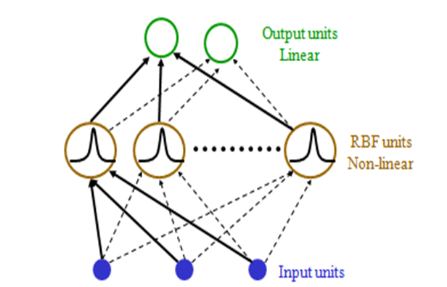
RBF Network’s Architecture

Slide 3
RBF’s
RBF Networks take a slightly different approach. Their main features are:
They are two-layer feed-forward networks.
The hidden nodes implement a set of radial basis functions (e.g. Gaussian functions).
The output nodes implement linear summation functions as in an MLP.
The network training is divided into two stages: first the weights from the input to hidden layer are determined, and then the weights from the hidden to output layer.
The networks are very good at interpolation.

Slide 4
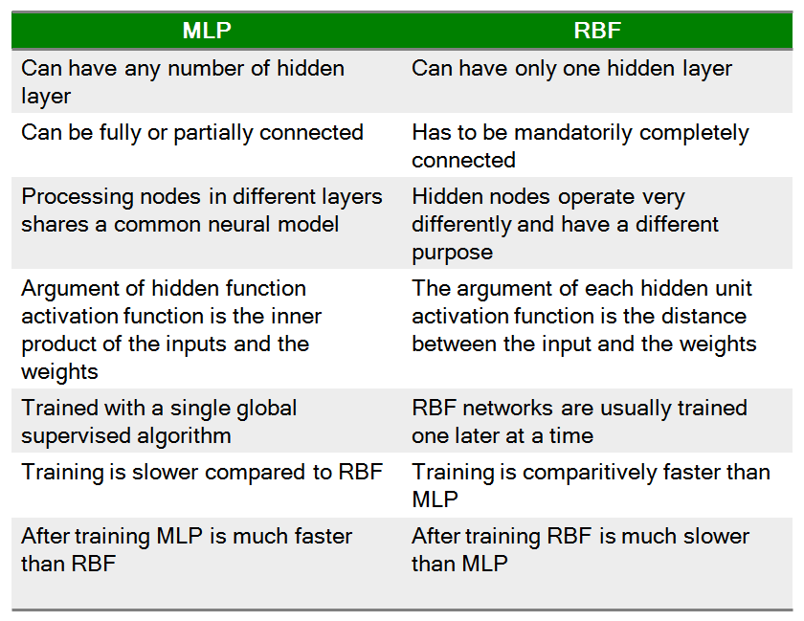
Comparison

Slide 5
Learning Methods
An MLP naturally separates the classes with hyperplanes in the Input space
RBF would be to separate class distributions by localizing radial basis functions
Types of separating surfaces are
Linearly separable - Hyperplane
Spherically separable - Hypersphere
Quadratically separable - Quadrics

Slide 6
Hyperplane-linearly separable
Hypersphere-spherically separable
X
X
X
X
X
X
X
X
Quadratically separable- Quadrics
X

Slide 7
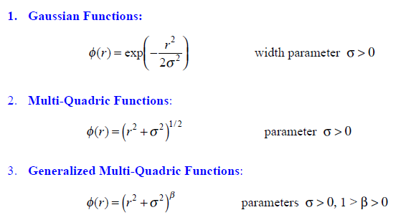
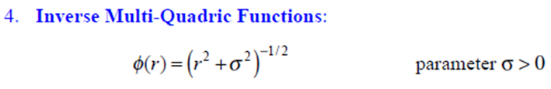
Some RBF’s

Slide 8
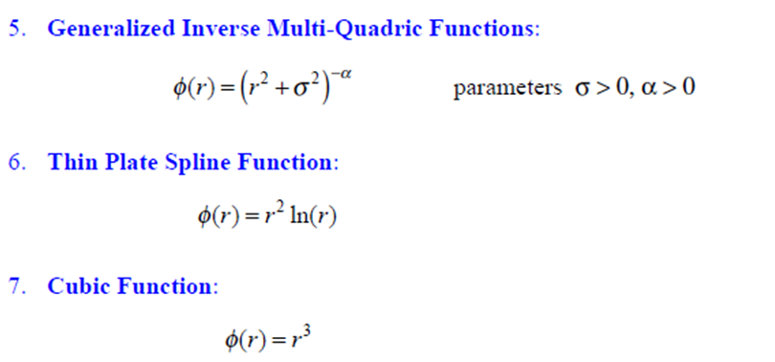
Some RBF’s

Slide 9
Improving RBF Networks
We can take the basic structure of the RBF networks that perform exact interpolation and improve upon them in a number of ways:
The number M of basis functions (hidden units) need not equal the number N of training data points. In general it is better to have M much less than N.
The centres of the basis functions do not need to be defined as the training data input vectors. They can instead be determined by a training algorithm.
The basis functions need not all have the same width parameter s. These can also be determined by a training algorithm.
We can introduce bias parameters into the linear sum of activations at the output layer. These will compensate for the difference between the average value over the data set of the basis function activations and the corresponding average value of the targets.
Of course, these will make analysing and optimising the network much more difficult.

